Slide 1

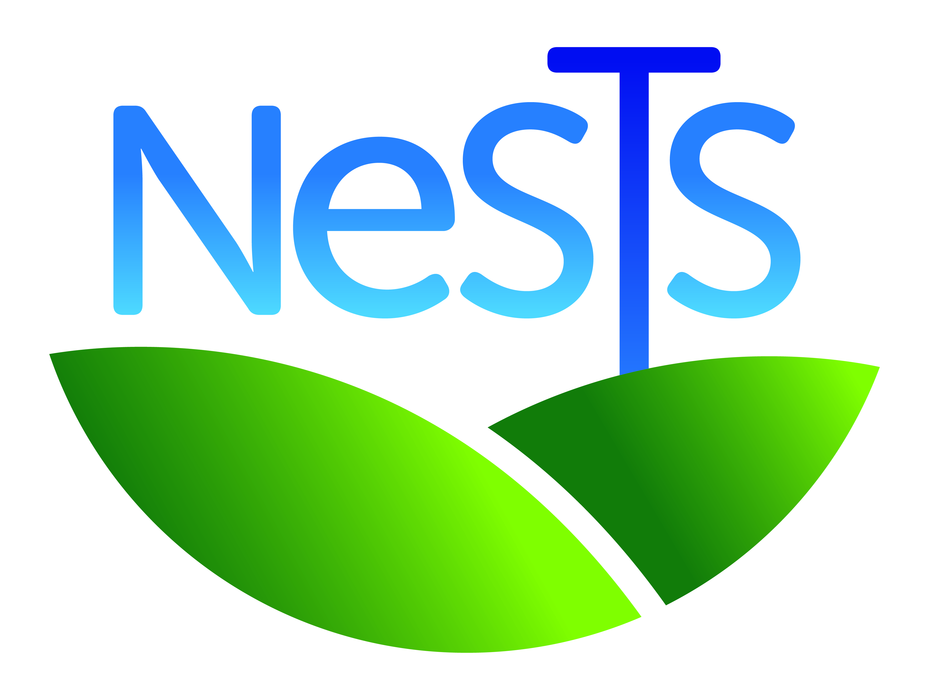
Information for the Low Carbon Networks Conference
October 2016
Notes:
Hi!

Slide 2
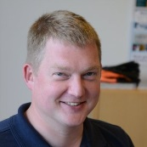
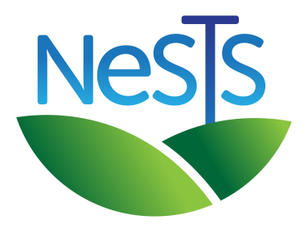
New Suite of Transmission Structures
£7.5m NIC 2015 project to develop new over head line supports which offer lower environmental impact, easier consenting, and lower lifetime costs.
  2016-2018 Design new structures & overhead line
  Stage Gate – deployment decision (with Ofgem)
  2019-2021 Construct overhead line
  2022 Publish e-tools and report
Based on NIA project work in 2014/15.
Tim.Sammon@sse.com
07469411397
www.NeSTSproject.com
Notes:
NeSTS stands for New Suite of Transmission Structures. The idea is to design and build an overhead line using new structures which have less environmental impact, cause stakeholders less concern, and are therefore easier to consent than those using current lattice steel designs. It is doing a similar job to the T-pylon project, but at different voltages and capacities, and in different geographies.
I’m Tim Sammon, the project manager.
The Project is funded by the Network Innovation Competition, which awarded it £7.5m in 2015. It will design and test the new structures and design an overhead line using them by 2018.
There is then a stage gate to decide whether to construct the new design based on its performance. If the stage gate is passed, the project will build the new overhead line by 2021 before publishing design tools and closing reports in 2022.

Slide 3
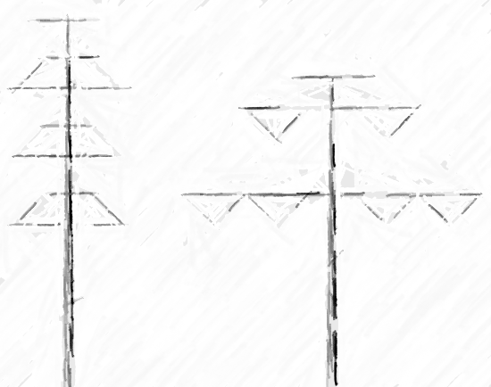
Constraints and Functional Requirements
=> current safety
<= current cost
Easier/different consenting.
Full and safe working access under single circuit outage.
Climbable using lines and clickers.
Mistake proof demarcation and access.
Clearance to lower conductors past lower arms/conductors vertically.
Foundation:structure modularity.
Modular range of extensions & fittings
Notes:
Our work is subject to important constraints. It must produce structures and overhead lines which meet or exceed current safety standards and performance, and, it must deliver these at lower or equal cost to customers.
Our internal stakeholders compiled many functional requirements related to making overhead lines which are easier or different to consent. These cover environmental impacts of the structures themselves and their construction, their impact on wildlife, and their visual impact on the landscape.
Some other functional requirements are shown here;
We must be able to inspect and repair/replace any structure mounted equipment under a single circuit outage.
The structures must be climbable using lines and clickers.
They must enable mistake proof demarcation and access.
We need clearance to lower conductors past lower arms/conductors vertically.
And, we want to design modularity into the foundation interface, extensions & fittings.

Slide 4
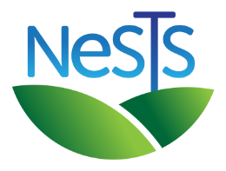
Concept Comparison and Assessment
Notes:
The NIA project developed eight design concepts and an assessment matrix tool to enable the complex task of comparing them.
Our first task has been to expose this work to our stakeholders, refine and publish the tool, and select a design concept to progress into detail design.

Slide 5
Main Design Aspects
Notes:
The matrix enables weightings to be applied to main design aspects.
These are;
Electrical, which compares the electro-magnetic and related performance of the designs;
Supports & foundations, which compares the implications of their structural form from many practical perspectives;
Mechanical and Electrical, which compares their mechanical aspects of supporting and insulating electricity conductors;
Construction, which compares their attributes in relation to construction;
Maintenance, which compares how each design would enable maintenance;
Operational Safety, which compares how safely the structures and the conductors they are supporting can be accessed; and
Environmental, which compares the structures in terms of their impact on the environment.
The weightings allow users to specify their perspective for comparing designs, and enables sensitivity analysis to examine a comparison’s robustness to different perspectives.
The weightings shown here are those based on Scottish and Southern Electricity Network’s perspective for this project.

Slide 6
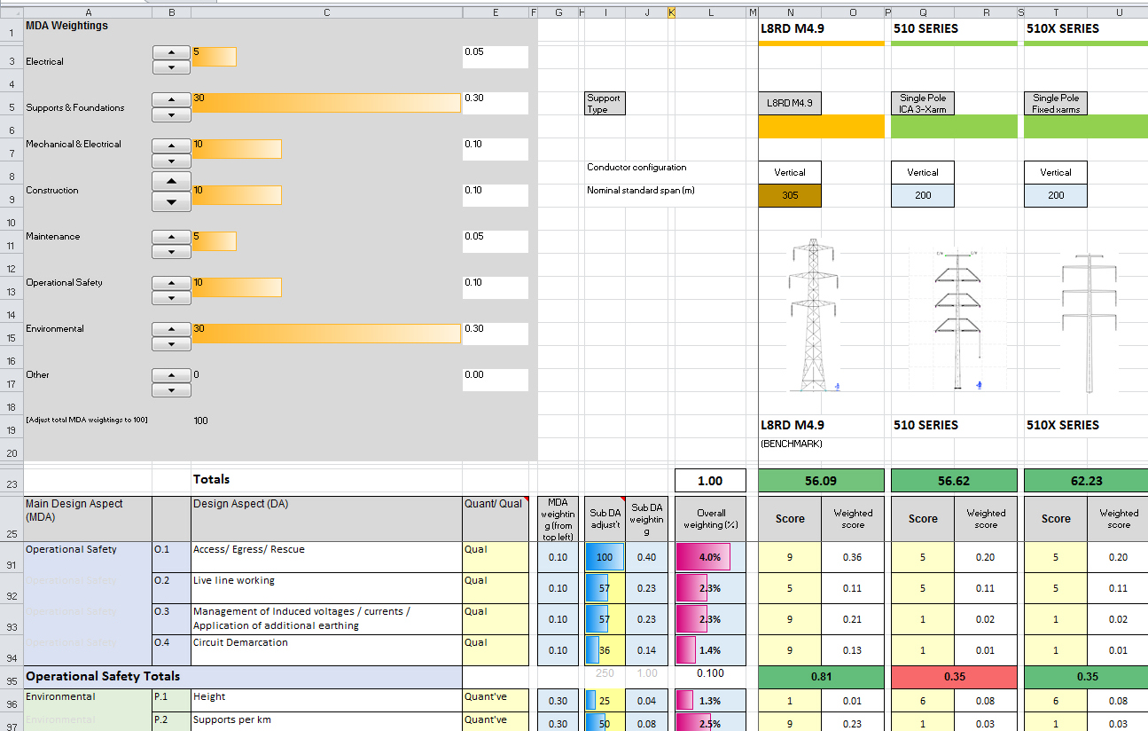
Design Aspects
Notes:
Each of these is then broken down into its design aspects for detailed scoring.
For example, operational safety is broken down into 4 design aspects; Access/Egress/Rescue, Live line working, management of Induced voltages / currents / application of additional earthing, and circuit demarcation.

Slide 7
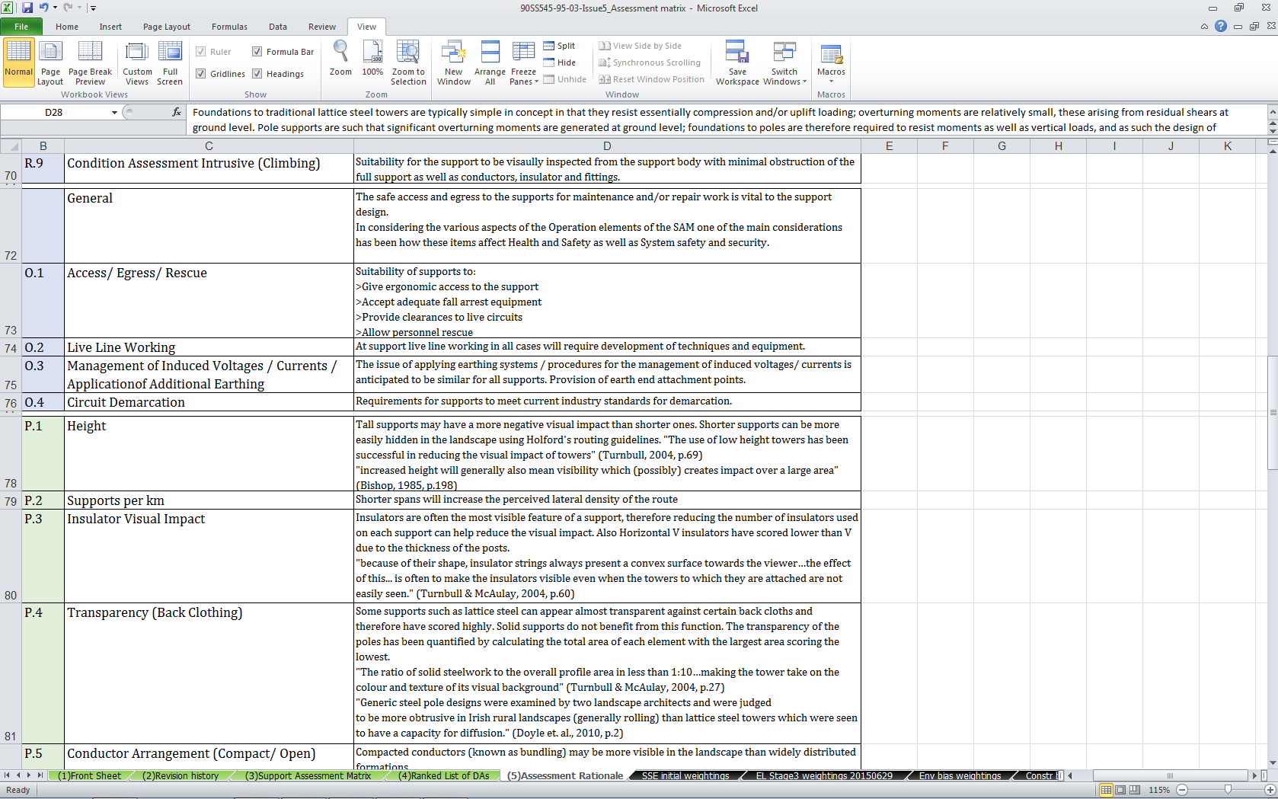
Rationale
Notes:
Each of these is explained in the rationale tab of the assessment spreadsheet.

Slide 8
Scoring
Notes:
Each design aspect is weighted within the main design aspect, by entering values into the Sub DA adjustm’t column.
The spreadsheet forces these relative numbers to divide the whole main design aspect weighting across the design aspects, and annotates the resulting overall weighting of the design aspect.
Design concepts are then scored between 1 and 9 comparatively depending on their performance in each aspect.
The score is multiplied by the overall weighting to generate a weighted score.
These are then summed to generate an overall score for each design concept.

Slide 9
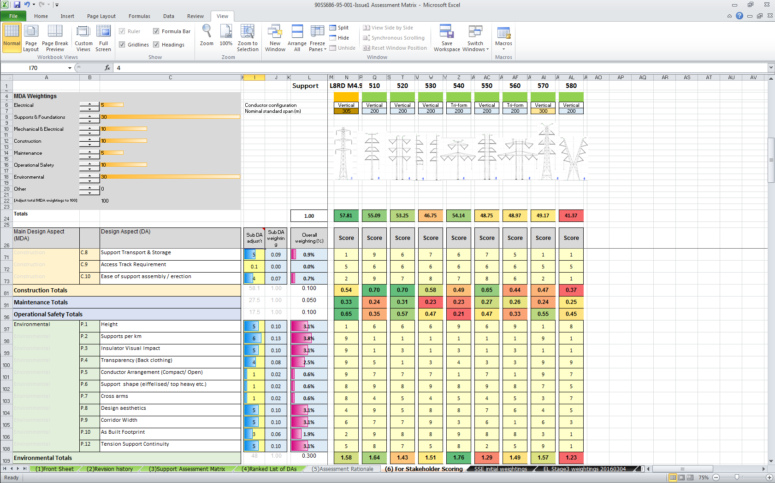
Environmental Design Aspects
Environmental Design Aspects
Notes:
Clearly, the design aspects need to be debated and scored by experts in the field, which is what we have done.
We then asked our Consultee Stakeholders to score and weight the Environmental design aspects during an event where they were exposed to visualisations and models of our concepts and to an interactive discussion of the design constraints and trade offs with the project design team and independent landscape architects.

Slide 10
Statutory Consultee Response
Notes:
This chart shows their scores for aesthetics. Each dot represents a stakeholder organisation’s scoring of the design concept below it. The lines make it easier to pick out their relative opinions of the concepts.
The 510 scores best and produces the highest degree of convergence.
The 540 produces the most divergence.
The X-pylon didn’t do very well!

Slide 11
Statutory Consultee Response
Notes:
This chart shows the stakeholder’s summed weighted scores for the environmental design aspects.
All score the 510 series best.
This concurred with independent assessment by landscapes architects including the late Mark Turnbull.

Slide 12
Stakeholder Input
Span
  Want fewer structures, extra height ok.
  Except sometimes!
    The NeSTS suite will cater for both, congruently.
Maintenance
  Need all operations catered for in detail.
    E.g. how to replace insulator when it is the cross arm?
Notes:
There were other significant inputs to the design process gathered during stakeholder engagement.
Firstly, regarding span.
The concepts were originally designed for a standard span of 200m, resulting in lower height than the benchmark L8RD lattice support.
This evolved in response to stakeholder input to a standard span of 300m with a corresponding height similar to the L8RD which will form the basis of the NeSTS designs.
Stakeholders advised that the lower number of structures in an overhead line offered by the increase in standard span, and the consequent reduced visual clutter and requirements for access, more than offset the impact of increased height in most circumstances. A requirement for the suite of structures to provide for congruent, lower height sections of overhead line for occasions when this is not the case has been added to the Project design brief.
Next, a detailed working through of maintenance procedures has revealed some interesting issues;
How do you replace an insulator when it is the cross arm?
And how do you support the conductor while doing it?
And, before solving those problems, how do you earth the conductors while maintaining safety clearances to insulators when they attach to the pole you are climbing?
Benchmarking so far has revealed that others using horizontal vee configurations of insulators are using MEWPs for access and cranes to support conductors, but we have constrained the project such that maintenance must be possible with climbing access and hoisted equipment.
More on that next year…or at our stand if you’d like to discuss it with me.

Slide 13
Stakeholder Input
Tension support continuity
  Need to develop tension designs at the same pace as suspension and ensure visual continuity.
Insulator configuration
  Vees are unattractive compared to I strings.
Notes:
We produced models and Landscape and Visual Impact Analysis based on suspension structures, and while tension supports were drawn, shared and discussed with stakeholders, and visual continuity between the suspension, tension, and termination supports is scored in the SAM, the project team feel we underdid it.
So we are producing another Landscape and Visual Impact Assessment to look at tension support continuity in more detail with our stakeholders.
While the 510 concept is a clear winner, stakeholders did report some unease with the appearance of insulators configured in horizontal vees. A preference for suspended insulators was stated.
As you’ll see on the next slide, these help with tension support continuity too.

Slide 14
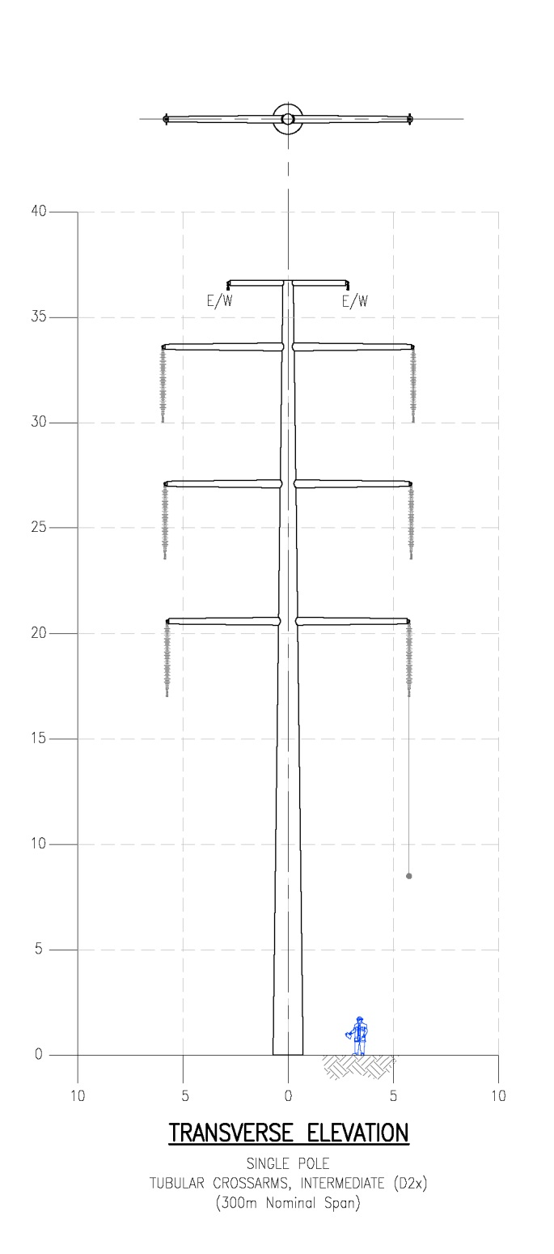
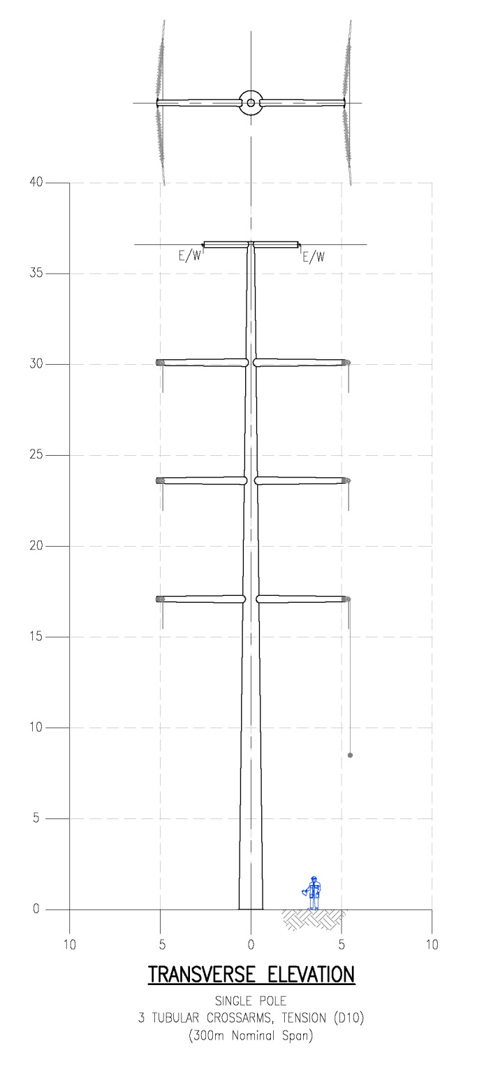

NeSTS Design
Notes:
So the NeSTS design will be based on the 510 series concept. It will be based on monopole construction, use I-string insulators, and support 2 circuits and 2 earth wires.
This slide shows the current status of the D2, D10, and D30 designs. The main poles are around a meter in diameter at the base, and half a meter at the top for the D2 suspension pole. These dimensions increase as the angle of deviation increases through the suite.
We have a 1:20 scale model of the suspension pole at our stand which will help to contextualise these drawings.

Slide 15
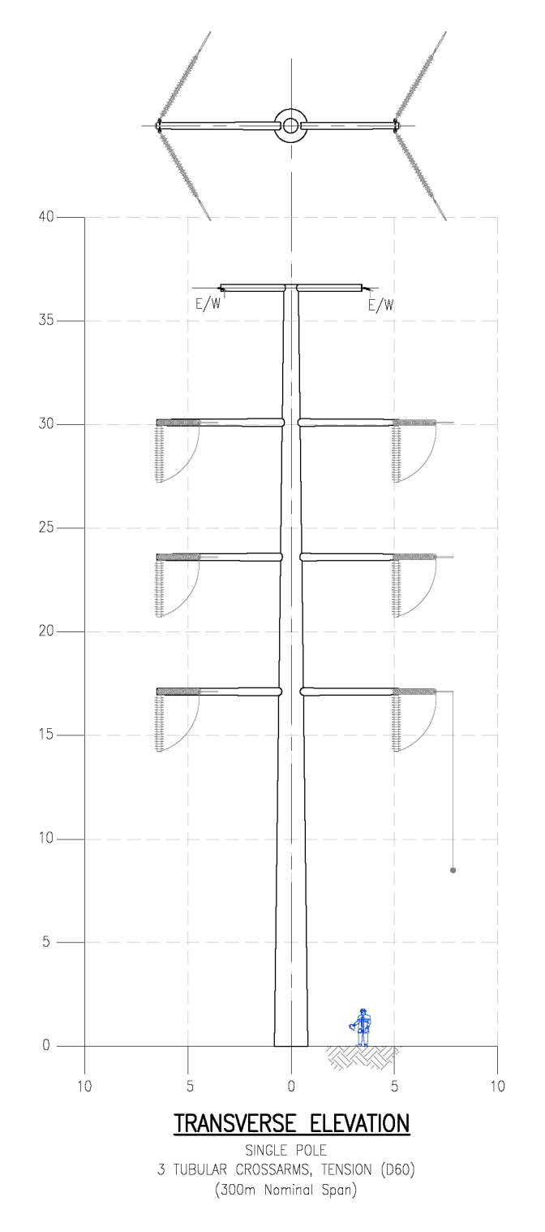
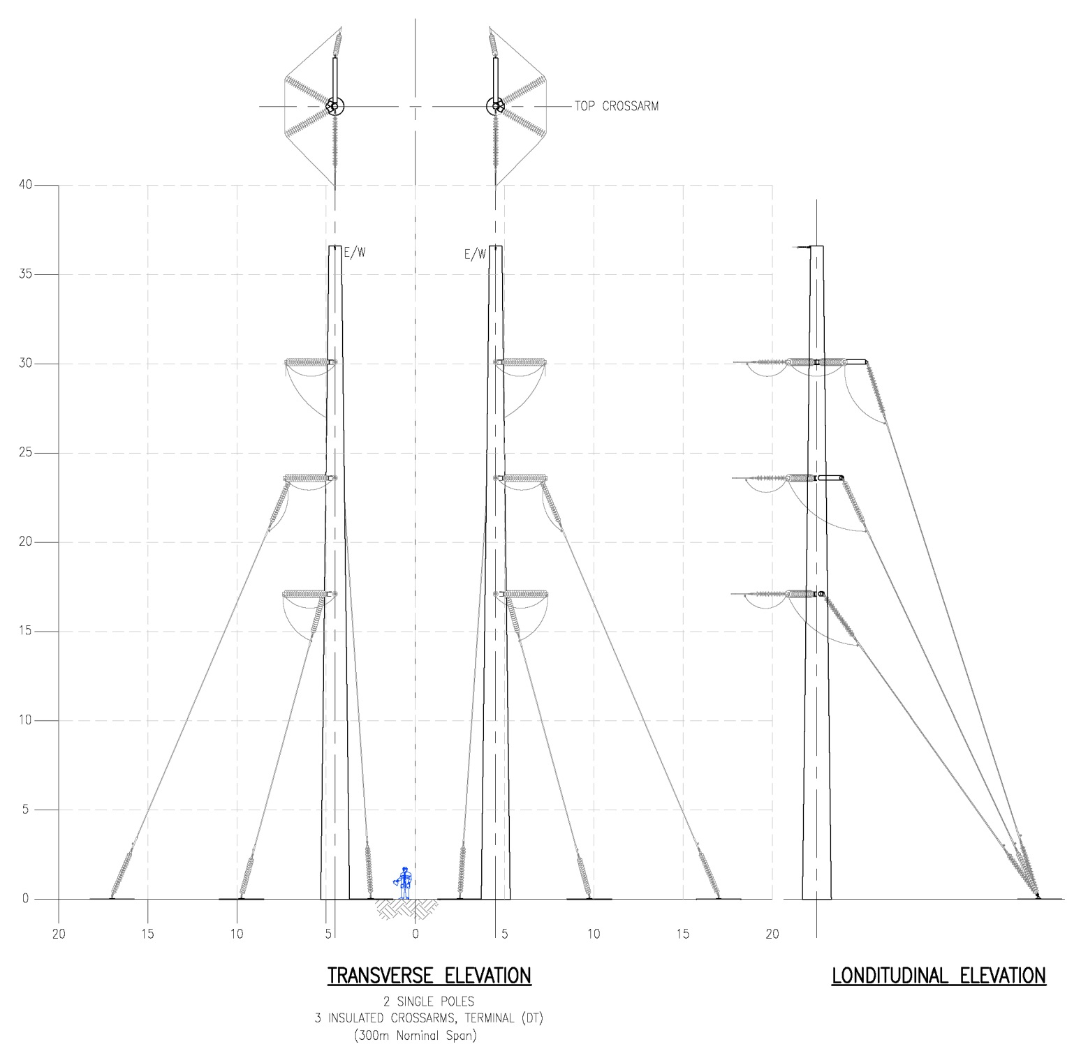
NeSTS Design
Notes:
This slide shows the D60 and two elevations of the termination support design for the suite. You’ll notice that we have used 2 poles for the termination support.
We anticipate incorporating further twin pole tension designs in the suite and are working on visualisations of these now to share with stakeholders.

Slide 16
New Suite of Transmission Structures
Design Particulars | Heavy Duty 2x1450MVA, 275kV |  | Medium Duty 2x1152MVA, 275KV |  | Light Duty 2x725MVA, 275kV
Conductor | 2 x 700 Araucaria | HS Keziah eq OPGW | 2 x 500 Rubus | HS Keziah eq OPGW | 1 x 700 Araucaria | HS Keziah eq OPGW
Rated temperature ( °C) | 90 | N/A | 90 | N/A | 90 | N/A
EDT (kN@°C) | 40@5 | 19@5 | 34@5 | 19@5 | 40@5 | 19@5
MET (kN@°C) | 50@-20 | 27@0 | 42.5@-15 | 27@0 | 50@-20 | 27@0
MWT (kN/°C/mm radial ice) | 193/ -10/60 |  | 131.6/ -10/max load |  | 193/ -10/60
Standard span (m) | 300 | 300 | 300 | 300 | 300 | 300
Max sum of adjacent spans (m) | 660 | 660 | 660 | 660 | 660 | 660
Max single span (m) | 450 | 450 | 450 | 450 | 450 | 450
Max wind span (climatic) (m) | 330 | 330 | 330 | 330 | 267 | 268
Maximum weight span (m) | 600 | 600 | 600 | 600 | 400 | 402
Minimum weight span (suspension supports) (m) | 182 | 182 | 182 | 182 | 147 | 147
Maximum equivalent span (m) | 300 | 300 | 300 | 300
Max altitude (m) | 500 | 500 | 300 | 300 | 300 | 300
Wind speed (mean hourly) (ms-1) | 28.5 | 28.5 | 27 | 27 | 25 | 25
Radial ice (no wind) (mm) | 77.5 | 77.5 | 72.5 | 72.5 | 75 | 75
Radial ice (with wind) (mm) | 27.5 | 27.5 | 22.5 | 22.5 | 25 | 25
Radial ice cap(mm,no wind/wind) | No cap | No cap | No cap | No cap | 60/22 | 60/23
Terrain category | II | II | II | II | II | II
Reliability level | 3(2) | 3(2) | 3(2) | 3(2) | 2 | 2
Notes:
One reason for this is that the supports I just showed will be the lightest in the suite. The Project is designing the suite to cover the heavy, medium, and light duties detailed in this table.
The heavy duty structures in the suite will support twin Araucaria conductors, insulated at 275kV and engineered for high altitudes in the North of Scotland at reliability level 3 (2).
The medium duty structures in the suite will support twin Rubus conductors, insulated at 275kV and engineered for 300m altitudes in Central Scotland at reliability level 3 (2).
The light duty structures will support singla Araucaria conductors, insulated at 275kV and engineered for 300m altitudes in Central Scotland and reliability level 2.
The decision to focus on insulating the suite for 275kV has been driven by desire to build upgrade potential into any deployment at 132kV, and a comparative reduction in foreseen benefits at 400kV.
For those wanting to look at these numbers in more detail than this time (or font!) allows, this presentation is published on the project website.

Slide 17
Next Steps
Stakeholder engagement;
  Supply chain
  Consultees
Detailing and prototyping;
  Access arrangements
  Cross arm design and jointing
Selecting an OHL for parallel design.
Notes:
At this stage we intend to meet all of the functional requirements we discussed and have started detailing and prototyping designs to demonstrate how.
The Support Assessment Matrix has been supplied to the other TOs and is available, along with the NeSTS worked examples, on the project website.
The headline areas we are working on now and next are;
Stakeholder engagement
We are visiting steel pole manufacturers to understand the opportunities and constraints of their products and processes.
We are working with insulator and ancillary equipment suppliers to incorporate their products, services and ideas in our designs.
And we are working with main contractors to ensure our designs enable efficient construction, operation, and maintenance, and embody their ideas and innovations.
We will continue our dialogue with consultee stakeholders with additional landscape and visual impact assessment, and updating them with the results of detail design.
Detailing and prototyping;
Access arrangements – internal/external
Cross arm design and jointing
Selecting OHL for parallel design.

Slide 18
www.NeSTSproject.com
Notes:
I’m looking forward to showing you the detailed designs next year. In the meantime, do get in touch directly or via the website at www.NeSTSproject.com
Thanks!

